Slide 1

Software Usage Tutorial Holy Book Similarity Analysis
CS410 Text Information Systems- Final Project
Graham Chester, John Moran
Notes:
The original motivation for this project was to see if topic modelling could be used to gain an understanding of the similarities (and differences) between the holy books of the worlds major religions. This idea evolved into building a general purpose tool, using commonly available software, that could analyse books from any source and plot a similarity map. So while the tool is general purpose, the use case presented for this project will be similarity mapping of major religions holy books, with some additional non-religious books from approximately the same period as the translations of the religious books to provide a comparison baseline.
Time= 52 seconds

Slide 2
Contents
Functionality Overview
Installation
Usage – Detailed Walkthrough
Use-Case
Conclusion
Notes:
In this presentation we will provide an overview of the functionality, an installation guide for both cloud and local machine, a discussion of how to use the tool, and a discussion of the holy book analysis use case.
Time=15 seconds

Slide 3
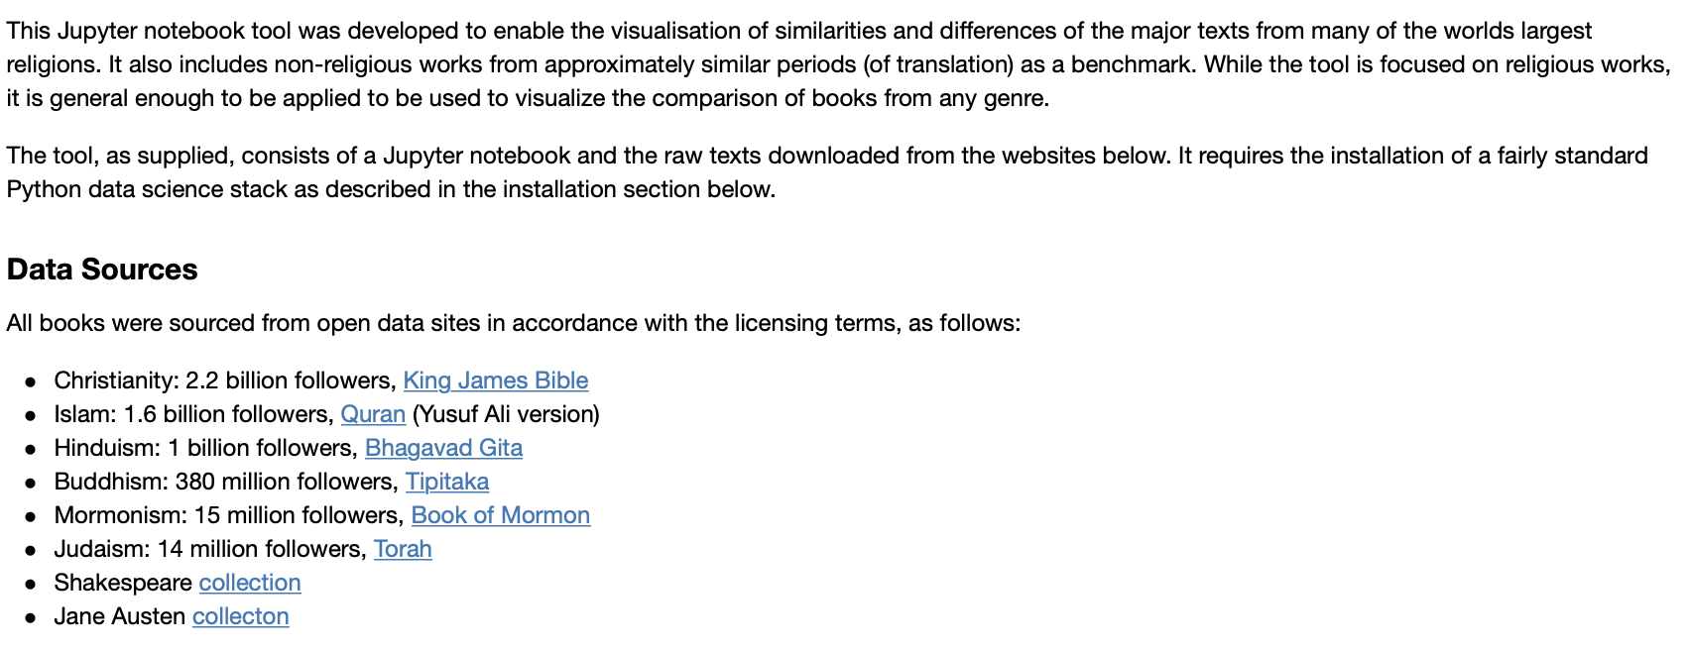
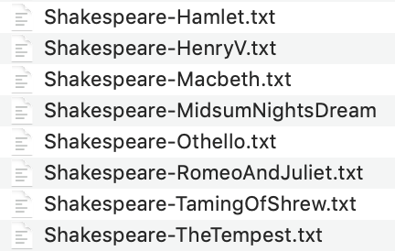
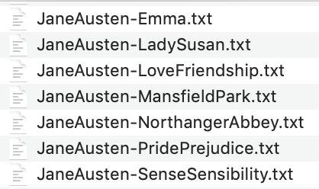
Functionality Overview
Github Repo: https://github.com/jfmoran2/CS410_Public
Notes:
The software stack chosen for this project is a Jupyter Notebook in Python, utilising the NLTK natural language toolkit for text processing, scikit-learn for modelling and similarity mapping, and pandas, and numpy for data manipulation.
The books downloaded were the King James version of the Bible from Christianity, the Quran from Islam, the Bhagavad Gita from Hinduism, the Tipitaka (tuh-pih-tih-kuh) from Buddhism, the Book of Mormon from Mormonism, and the Torah from Judaism. Additionally a selection of works from William Shakespeare and Jane Austen were included. URL links for the sources of these files are included both in the notebook itself and in the README file on the public github repo at the URL shown. The documentation shown in these slides is also included in the notebook and the README file.
Time = 51 seconds

Slide 4
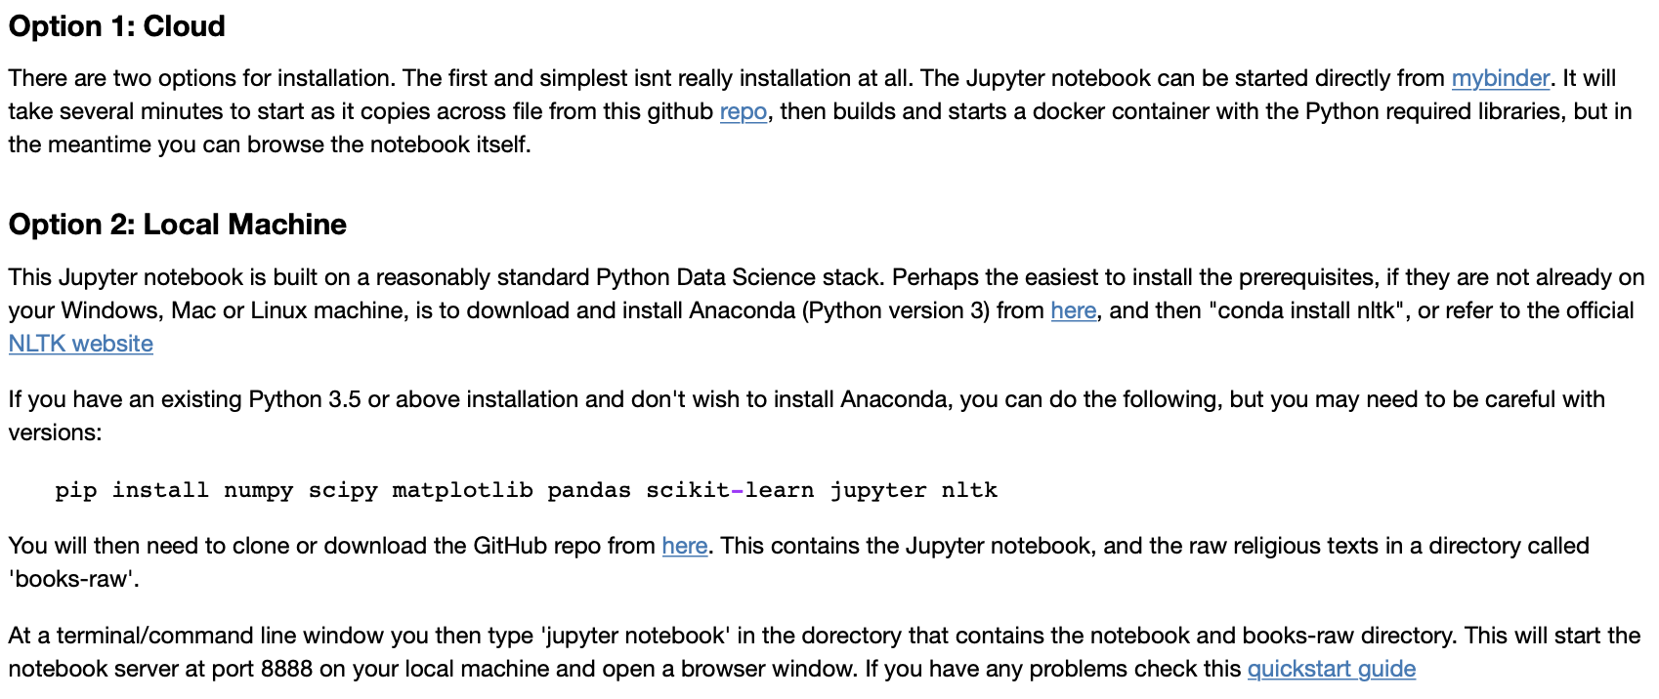
Installation
Notes:
There are two ways to access this tool, firstly via a cloud solution hosted by mybinder. This is technically the simplest solution, as it can be started by just one click from the README file in the GitHub public repo on the previous slide. The disadvantage is that it can take several minutes to startup since it copies across files from GitHub to mybinder, then builds a Docker container with Python and all the required libraries as specified in the requirements.txt file. Also the actual running of the notebook is slightly slower than if you run on a recent quad-core local machine. It is however an excellent way to get started, and avoids the complications of setting up on your local machine.
The second method is to install the tool on your local machine. Firstly a Python data science stack needs to be installed. Anaconda is recommended for this on Windows, Mac or Linux, but if you already have a Python version 3 environment on your local machine you will just need to pip install the libraries shown. Once your environment is setup you can git clone the repo on the previous slide, or download it as a zip file from that repo. The zip file contains the Jupyter notebook and a books-raw directory containing the raw text of the books discussed previously.
Time=78 secs

Slide 5
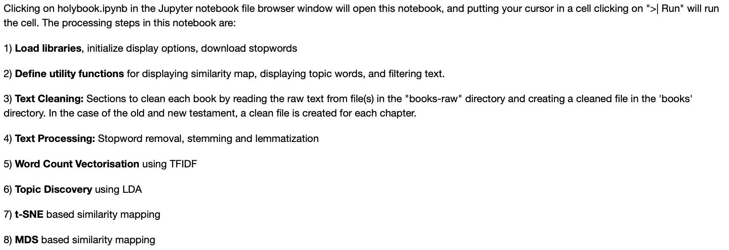
Usage Summary
Notes:
The Jupyter Notebook consists of the following sections:
Firstly a cell to import all required libraries, set display options etc, then a cell containing utility functions used throughout the notebook.
There is then one cell for each raw book file that processes and cleans that book.
We then perform some overall Text processing to prepare all books for modelling.
Then we do word count vectorisation, followed by Topic Discovery, and then similarity mapping using two methods.
These sections are discussed in detail on the following slides
Time=29

Slide 6
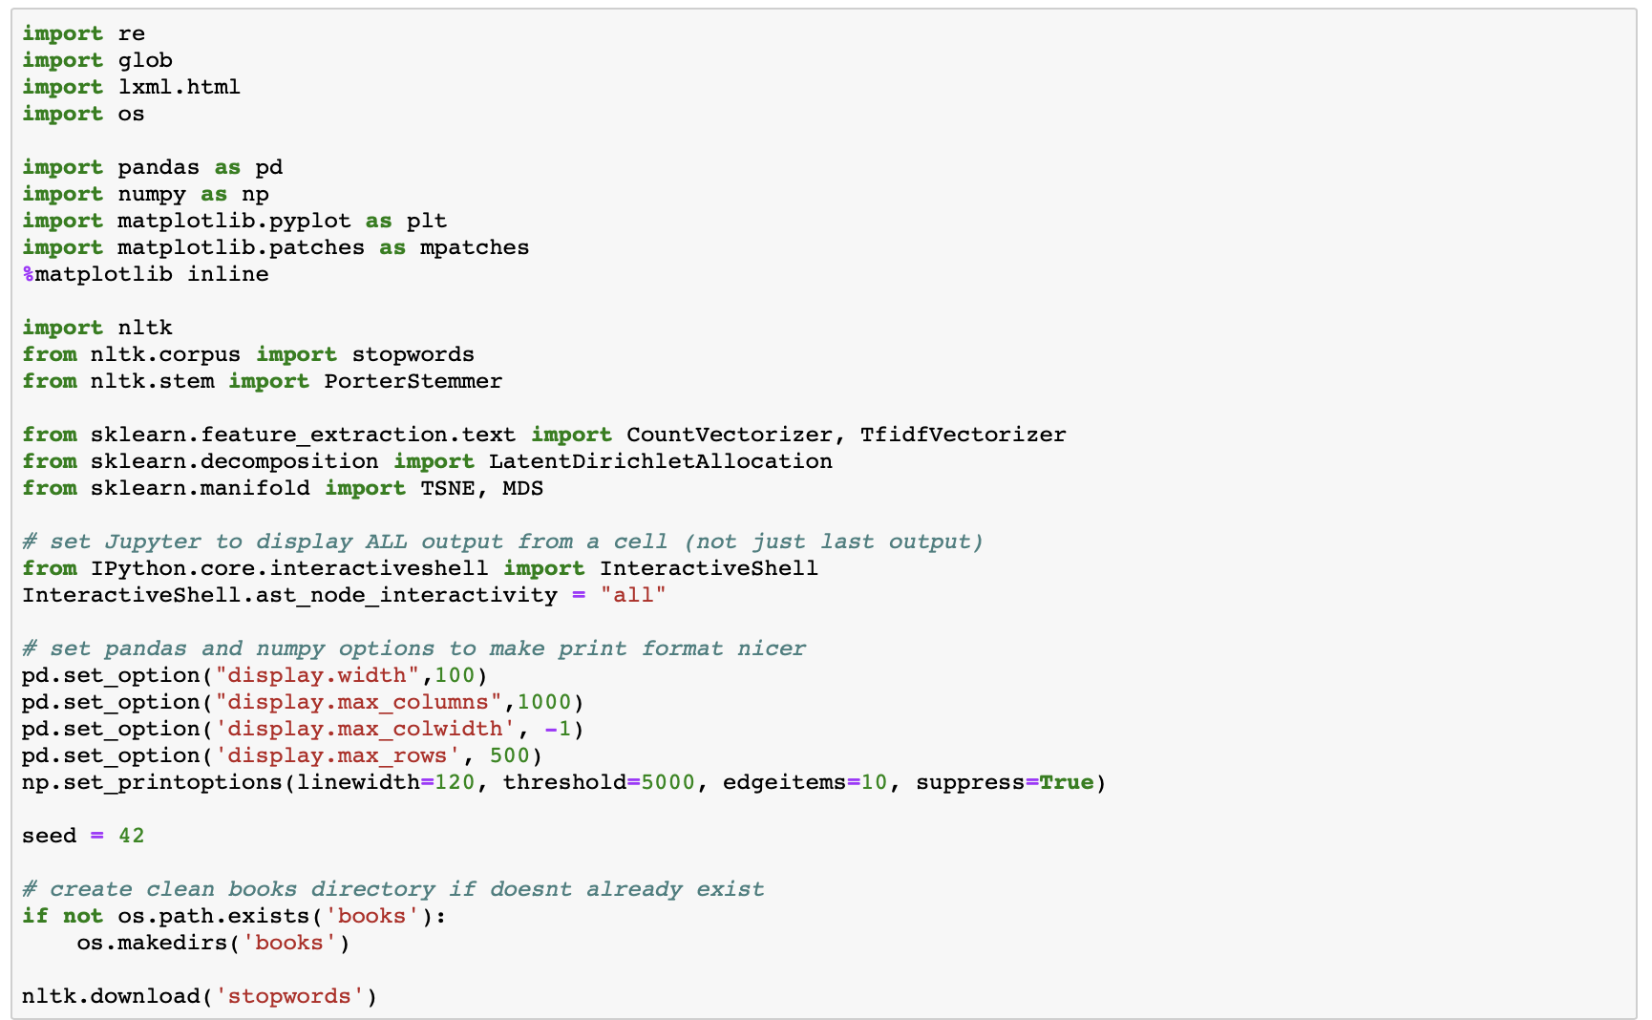
Usage – Imports and options
Notes:
This section of the code first imports some Python standard libraries that are used for regular expression matching (re), file reading and writing (glob and os), and html parsing (lxml). Then Pandas and Numpy are imported for text data manipulation and modelling, and matplotlib for generating the similarity map. NLTK (Natural Language Toolkit) is then imported for stopwords, stemming,and lemmatization. And lastly scikit learn functions are imported for word vectorisation, LDA topic modelling, and TSNE and MDS projection onto 2 dimensions.
Once the libraries are import various display options are set, the numpy random number seed is set for consistency of results, and finally the clean books directory is created if it doesn’t already exist, and the stopwords are downloaded if they have already been downloaded.
Time=48 seconds

Slide 7
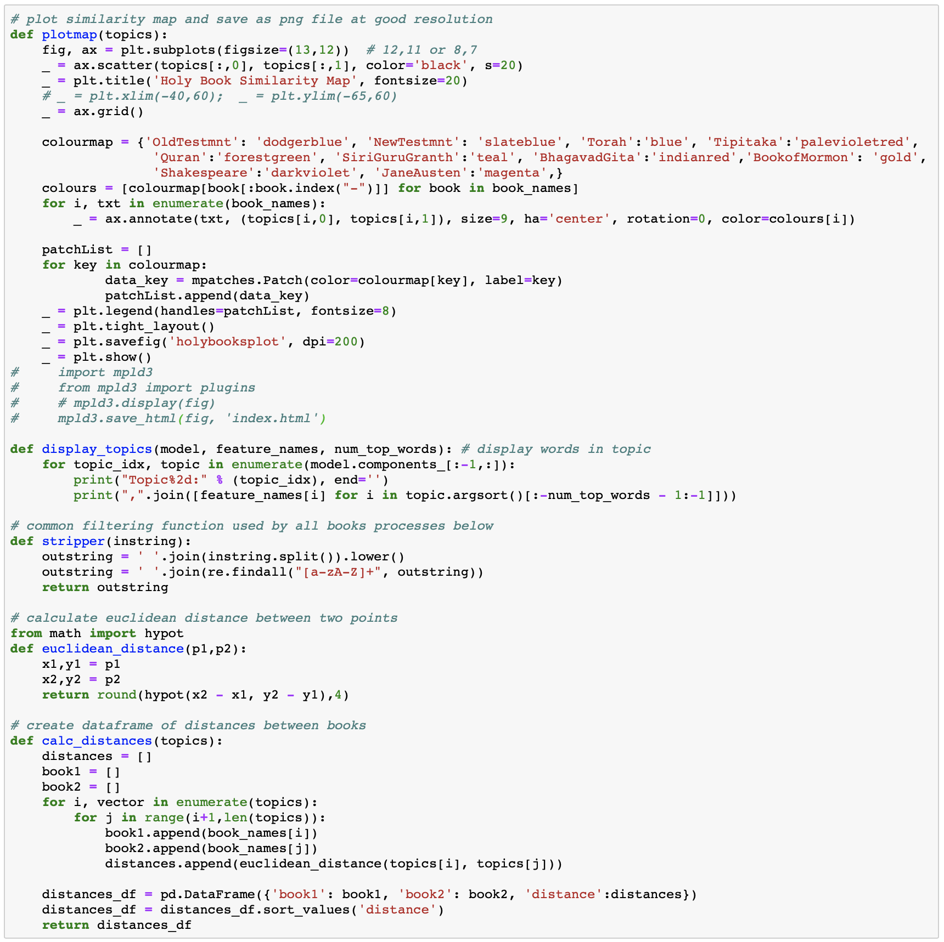
Usage – Utility Functions
Notes:
Several functions are defined for use throughout the notebook. Firstly a function to plot and format the similarity map, then a function to display the most important words in each subject in the LDA model. The stripper function is used to clean the raw book data, and the two distance functions are used to create a Pandas data frame of book to book distances from the output of LDA modelling.
Time=25 seconds

Slide 8
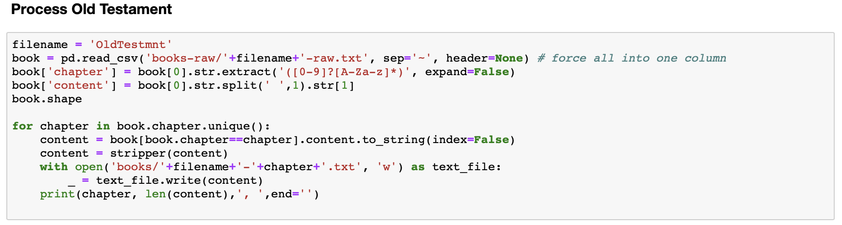
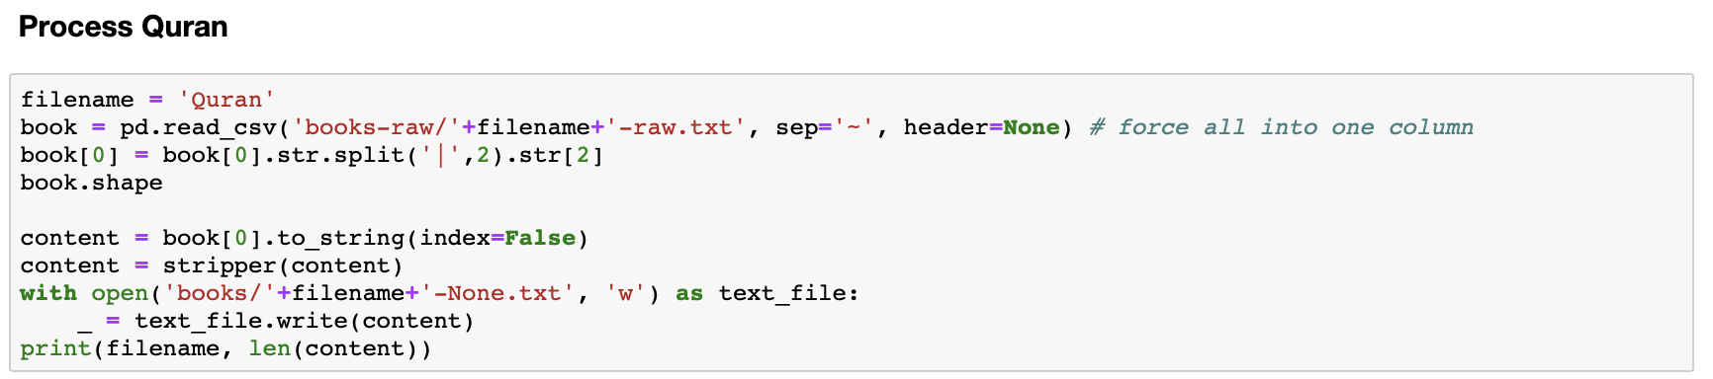
Usage – Book Processing
Notes:
All books are read from the books-raw directory and a cleaned version is written to the books directory. Books are processed in different ways depending on the content as follows:
New and Old Testaments are read as a single file for each, and the code splits these and writes a cleaned book for each chapter e.g. Genesis, Exodus etc
The Bhagavad Gita, Quran, Siri Guru Granth and the Book of Mormon are read as a single file for each and written as a single cleaned file for each
Shakespeare and Jane Austen are read as multiple files beginning with ‘Shakespeare’ (for example) and written as multiple files.
The Tipitaka is read as an entire directory which was downloaded as a whole website, then html parsing is used to extract the clean text from the html and write as a single clean file.
Time=47

Slide 9
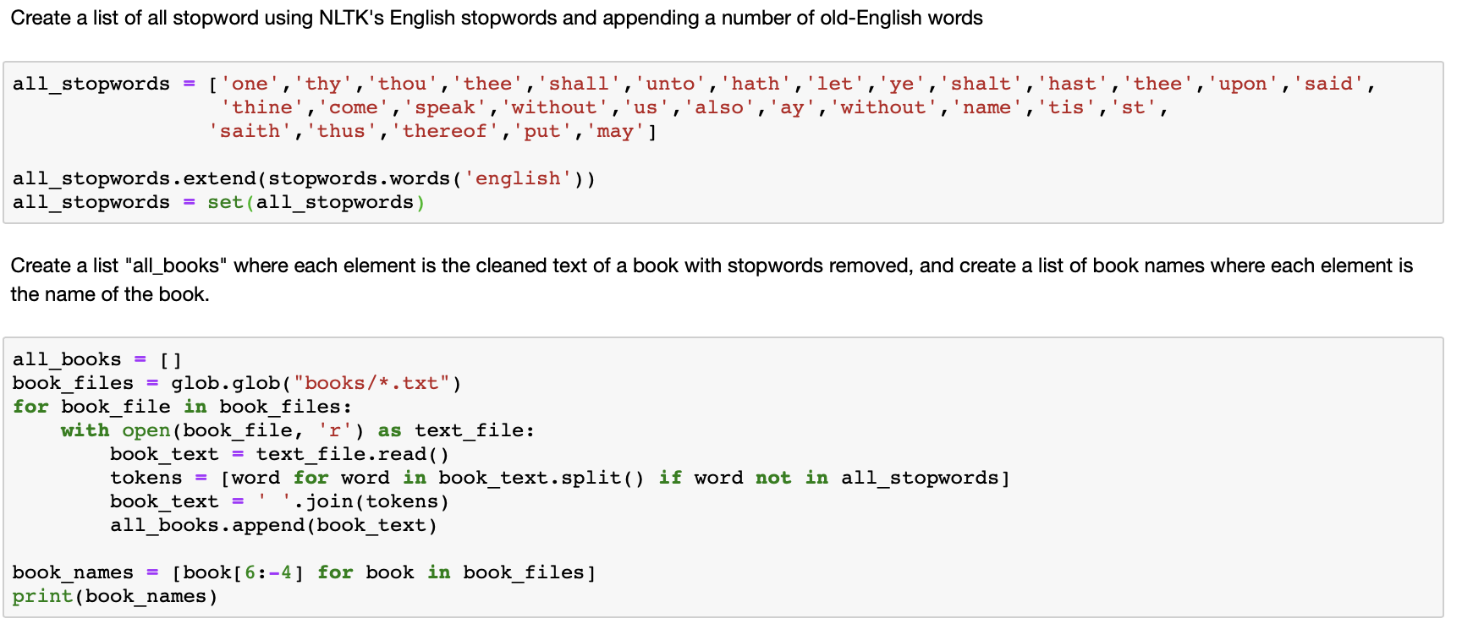
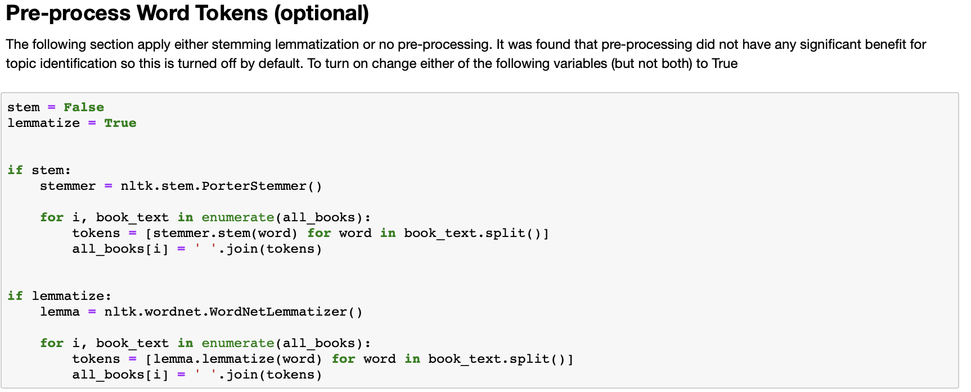
Usage – Text Preparation
Notes:
Text Preparation firstly prepares a set of stop words which include the English stop words from NLTK with the addition of some very common old-English stop words. It then reads all of the cleaned books from the previous step and create firstly a list of books text, then creates a list of book names.
Stemming or lemmatization can then be performed on the list of books text. It was found that lemmatization made a small improvement in topic differentiability, but practically speaking these activities can be regarded as optional.
Time=32

Slide 10
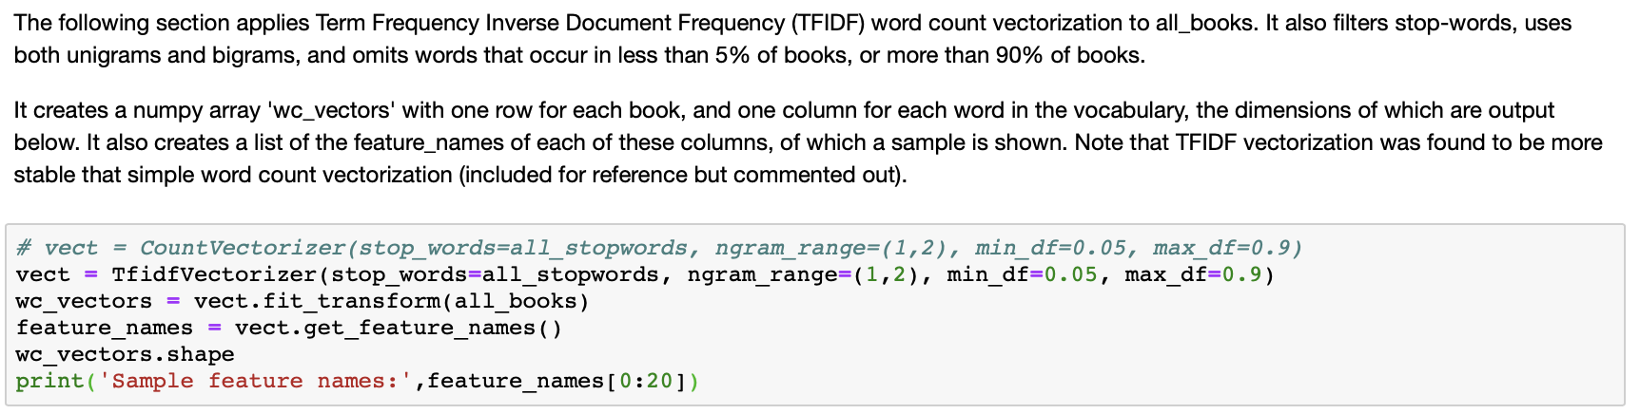
Usage – Vectorization
Notes:
Vectorization is the process of taking each books words or tokens and converting that to a matrix with the rows representing the books, and the columns containing a number. For the basic word count vectorizer, that number is simply the count of the number of words in the book, and the for the TFIDF vectorizer that number is the Term Frequency Inverse Document Frequency. It was found that the TFIDF vectorizer produced mode stable results in the topic modelling than did the simple word count vectorizer, but that is left as commented out for reference and completeness.
Additionally it was found that using unigrams and bigrams provided good topic modelling results, as did ignoring words that occurred in less than 5% of documents or more than 90% of documents.
The word vector matrix returned consists of one row for each book, and approximately 20,000 columns, one for each vocabulary word.
Time=53

Slide 11
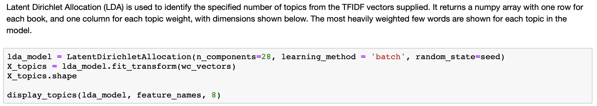
Usage – Topic Discovery
Notes:
Latent Dirichlet Allocation (or LDA) from the scikit-learn library was used for topic modelling. It was found that about 28 topics was a good balance between not enough to differentiate the books, and too many that were too similar. LDA takes the word vectors matrix and returns a topics matrix consisting of one row for each book and a column containing a weight for each topic.
Time=24

Slide 12
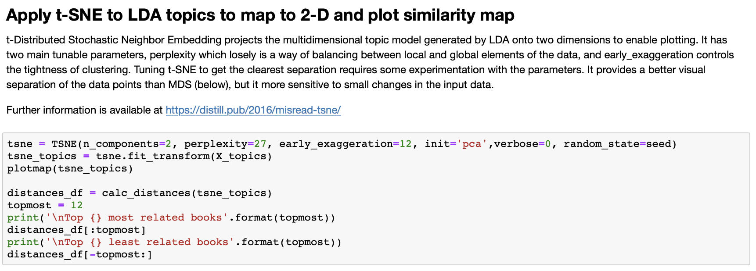
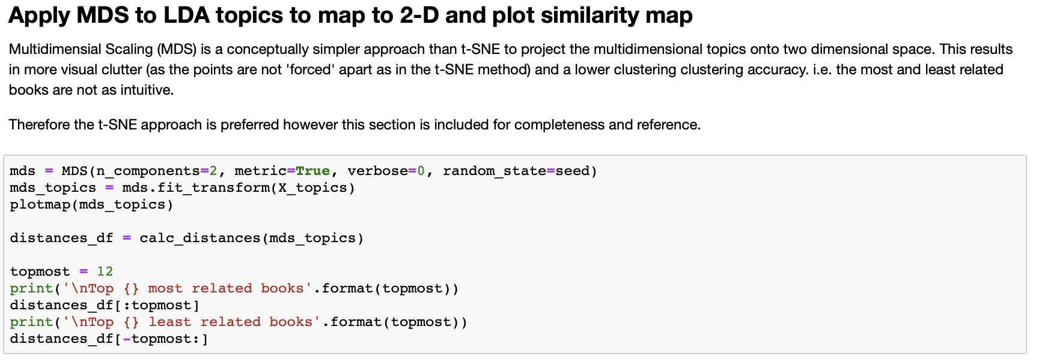
Usage – Similarity Mapping
Notes:
Two methods were used to project the 28-dimensional topic matrix from LDA, onto 2 dimensions for plotting. Firstly, and most successfully was t-SNE. This relatively complex algorithm has two tuneable parameters, perplexity which balances local and global regions of the space, and early exaggeration which controls the tightness of the clustering. It was found that values close to the defaults (of 30 and 12 respectively) provided good results. These parameters have a significant effect on the appearance so a deal of experimentation was required to get the best visual results.
MDS is a simpler algorithm that does not attempt to separate data points in the same way or degree as t-SNE, so the output is less visually appealing than t-SNE, though the overall groupings of data points are very similar.
Time=51

Slide 13
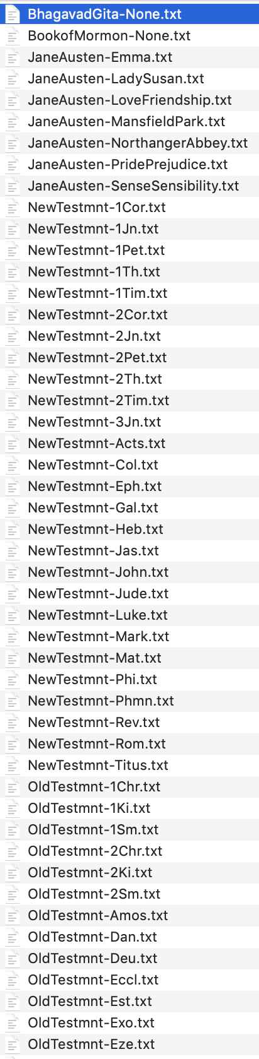
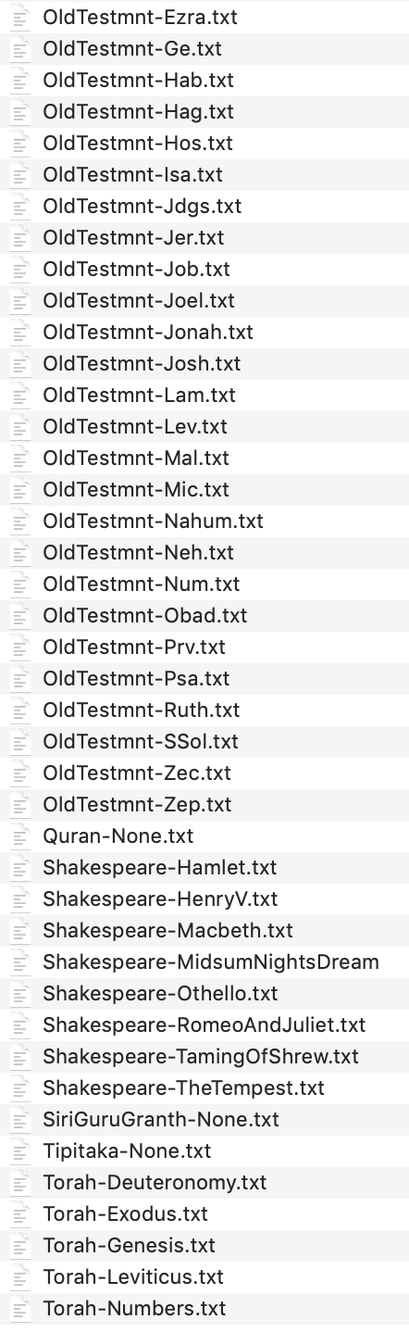
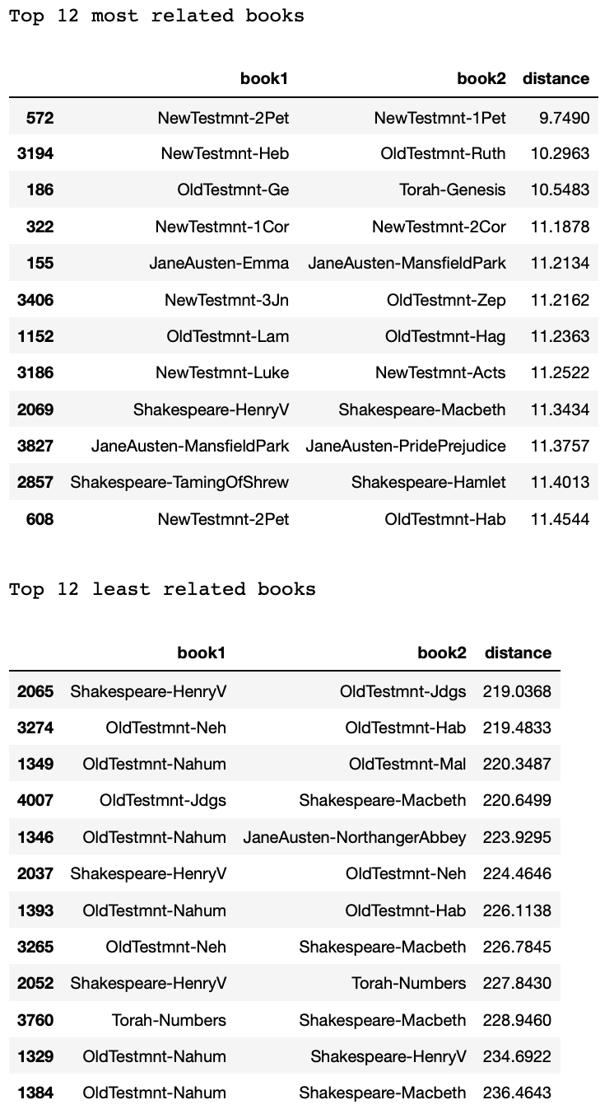
Use-Case – Holy Books
Notes:
As discussed at the start of this presentation, the primary use case was to analyse the similarities and differences of a selection of the world major religious texts, with some non-religious text from a similar period as the translations.
The books used in this similarity mapping are shown on the left, while the most and least related books are shown on the right. Whilst none of the team members are experts on religious texts many of the results seem to make sense. Two letters from Peter are unsurprisingly very similar. Old Testament Genesis and the Torah Genesis are also very similar despite the different translation times and different religions. Two Jane Austen novels are also very similar, as are some Shakespeare. Also many of the least similar books involve a Jane Austen or Shakespeare work combined with a biblical work. However there are some Old testament to Old testament books which are identified as very unrelated, however unfortunately our lack of biblical knowledge leaves this as unexplained.
Overall however, these results provide a good level of intuitive confidence that the algorithms used are working effectively.
Time =

Slide 14
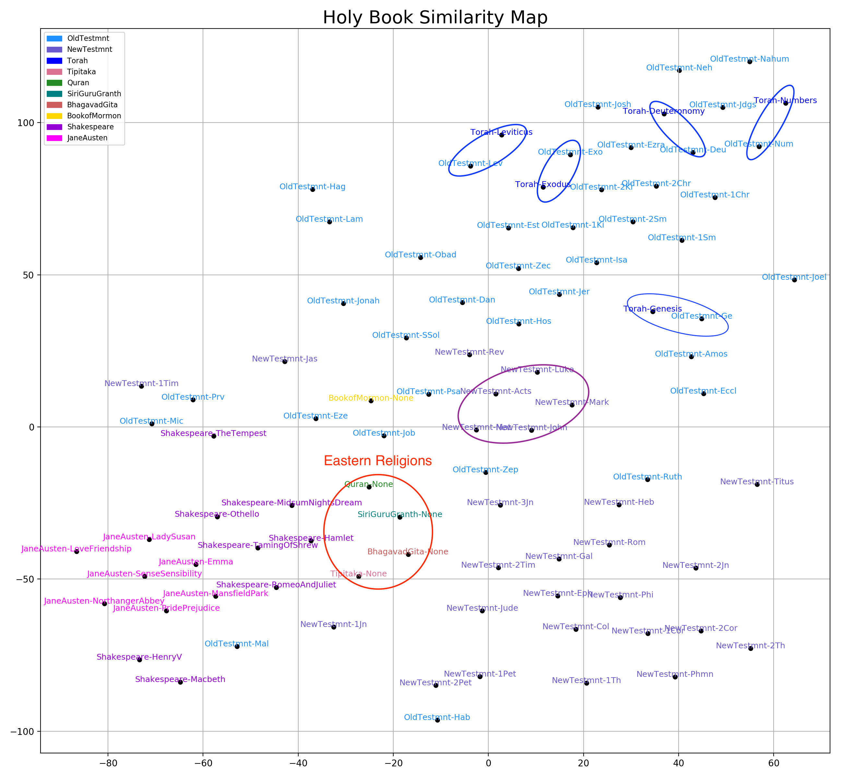
Use-Case
Topics Discovered
Notes:
This similarity map is the main and final output from the processing. Here with a red circle we can see the holy books of the eastern religions sitting in a reasonably tight group that is located in between the New testament, old testament and Shakespeare. We can see a loose grouping of the old testament and of the new testament. The books of the Torah are closely connected to their equivalent book in the bible. The New Testament book of Revelation which is similar in style to the Old testament books is located closer to the Old Testament than much of the New. The first four books of the New Testament are the oldest and they are also located close to the Old Testament books. The Book of Mormon also appears to be similar in style to the Old Testament. And lastly, unsurprisingly the Jane Austen novels are tightly grouped, and the furthest away from the religious books, at the other side of Shakespeare which is also relatively tightly grouped.
Time =

Slide 15
Conclusion
Similarity mapping tool is general purpose
Can be run in the cloud or locally
Detailed use-case: holy book similarity
Interesting results from the holy book analysis
Notes:
To summarise, we have successfully developed a general purpose book similarity mapping tool using commonly used Python libraries, and that can be run on the cloud or locally. We have also provided a detailed installation instructions, and a thorough walkthrough of the code functionality.
The results from the use-case are fairly non-controversial with all religious texts grouped together, away from the non-religious, and the general groupings reasonably as expected.
I hope you find this tool useful and the presentation informative. Thank you for your time.
Time =

